Slide 1
Data Presentation
Jennifer Nghi M. Nguyen

Slide 2
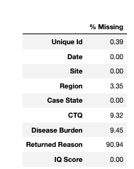
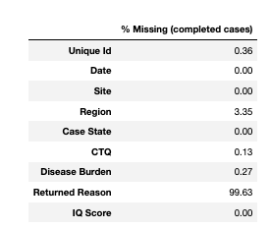
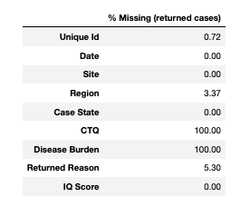
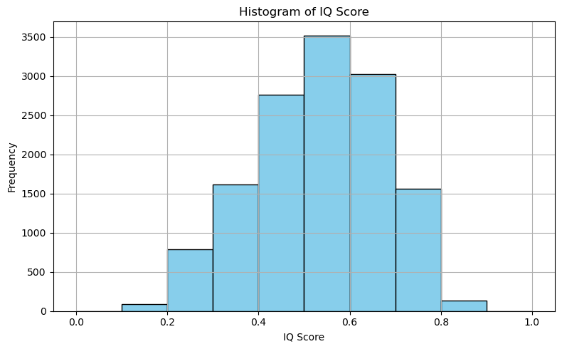
Analysis Setups
- Data Preparation -
Tools: Tableau, Python, Jupyter notebooks, Excel
Handling Missing data
- all missing returned reasons, disease burden, CTQ will be replace with ‘N/A’
- Missing disease burden and CTQ <1% → no imputation; ‘N/A’ used to represent missing
Handling Outliers:
42 rows with IQ score < 0 and > 1.
-> replace outliers with median IQ scores (0.54)
IQ Score distributions

Slide 3
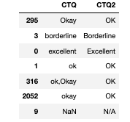
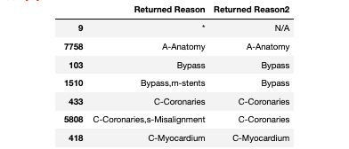
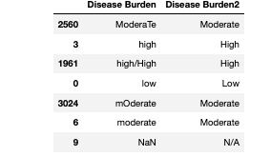
Analysis Setups
- Data Preparation -
Handling Inconsistent Data
- There are text data inconsistencies in return reasons, disease reason, CTQ columns
- Standardize text of return reasons, disease reason, CTQ into consistent format

Slide 4
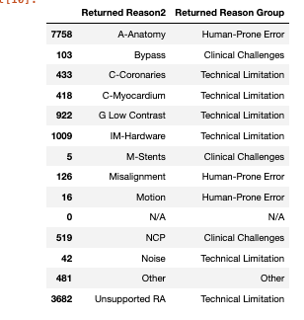
Analysis Setups
- Return Cases Trend Analysis -
Group cleaned Returned Reason into 3 main groups:
- Human-prone errors including motion, misalignment, anatomy
- Technical limitations including: noise, GLC, IM-Hardware, Unsupported RA, Myocardium, Coronaries
- Clinical challenges: Bypass, NCP, Stents
Use Tableau for analyzing
- Look at distributions & trends of IQ Score using histograms
- Look at trends of returned reasons and their categories, which categories have most returned and why, and what recommendations we can make from the data
- Show interactive visualizations as Tableau dashboards
Returned Reason Groups

Slide 5
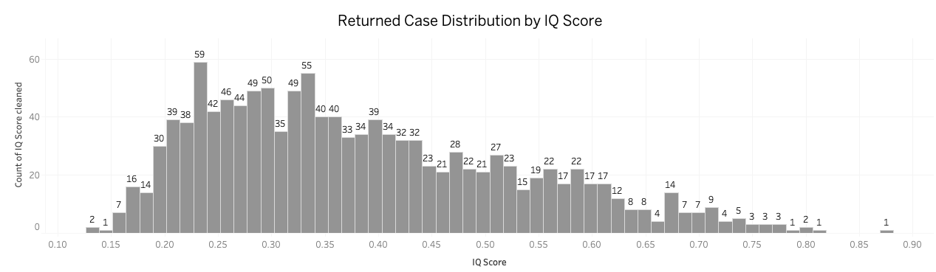
Returned Cases
- Are there any trends in why cases are being returned? -
- Most returned cases have IQ scores between 0.2–0.45 showing a right-skewed distribution, indicating primarily reasons for returned cases are due to low quality scans

Slide 6
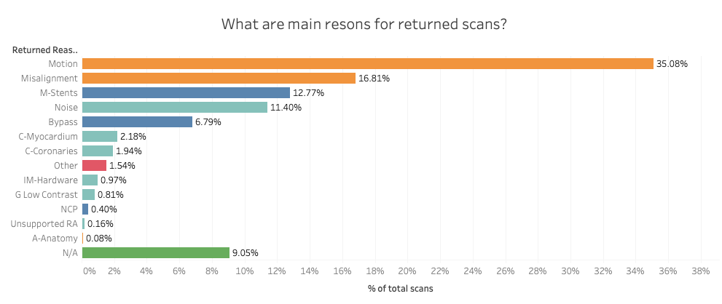
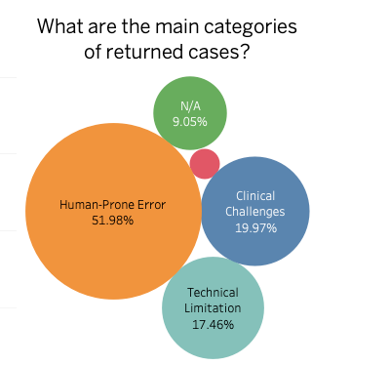
Returned Cases
- Are there any trends in why cases are being returned? -
- Human-prone errors (like motion and misalignment) account for over 50% of returns.
- Technical issues (like noise, hardware, and low contrast) make up about 17%.
- Clinical challenges (like stents, bypasses, and NCP) make up around 20%.
- 9% missing reasons

Slide 7
Returned Cases
- Insight Recommendations -
Focus on improving human-prone errors:
- Reduce motion errors: Coach patients on breath-hold and stillness before scanning; consider sedation for challenging cases.
- Address misalignment: Improve scanner setups, calibrations, and technologists trainings to be done properly.
Improving workflow:
- Optimize protocols:
- Adjust scanning protocols to reduce noise and improve contrast
- Training technologists to always log returned reason for understanding purposes.
- Prepare for known clinical challenges: Flag patients with stents or bypasses in advance and use tailored protocols.
Return Case Dashboard (dashboard.twb)

Slide 8
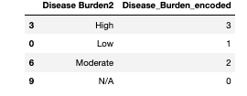
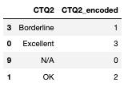
Analysis Setups
- CTQ/Disease Burden v. IQ Score -
Use Jupyter Notebook for next following steps:
1. Integer encoded CTQ and Disease burden columns
2. Filter to focus on completed cases
3. Clean data and replace missing data with median
4. Analyze spread and variability related to IQ Score
5. Analyze correlation between CTQ, Disease burden & IQ score

Slide 9
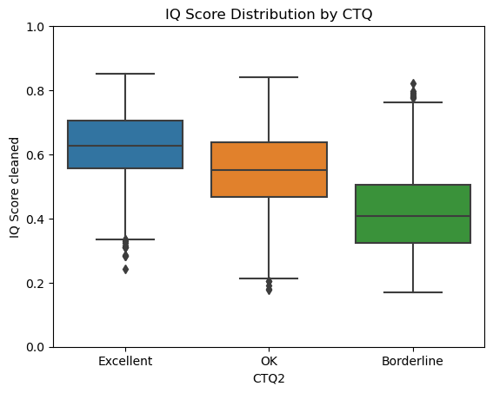
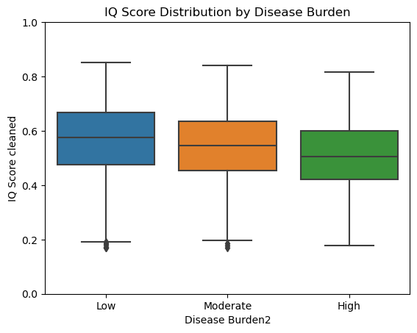
CTQ/ Disease Burden v. IQ Score
- Spread and Variability -
- Clear Positive Correlation: Higher CTQ is associated with higher IQ Scores. As CTQ drops to OK and Borderline, the median and overall IQ Scores decrease.
- Excellent CTQ shows a tighter distribution, suggesting consistent image quality.
- Borderline has a wider spread, which indicates more variability and poorer image quality.
- CTQ is strongly aligned with the quantitative IQ Score — confirming that the visual CT quality rating by analysts matches the IQ Score output
- Cases with low disease burden tend to have higher scores on average.
- As the disease burden goes from low to moderate to high, the scores go down steadily; so, the worse the burden, the lower the typical score.
- This suggests a negative correlation between disease burden level and the outcome score. However, the variabilities suggest that the correlation are not that cleared.

Slide 10
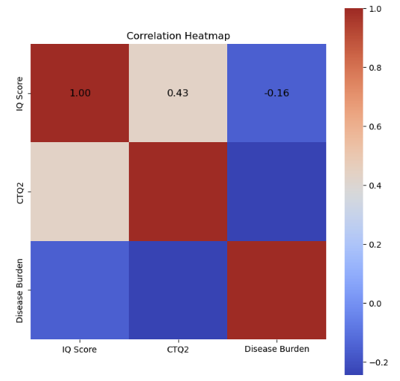
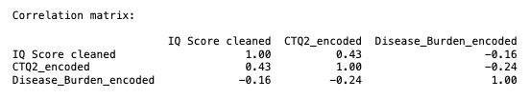
CTQ/ Disease Burden v. IQ Score
- How does the CTQ/Disease Burden assessment relate to the IQ scores? -
- The correlation between IQ Score and CTQ2 is 0.43, meaning there is a moderate positive correlation between these two variables.
- The correlation between IQ Score and Disease Burden is -0.16, indicating a very weak negative correlation.
- The correlation between CTQ and Disease Burden is -0.24, showing a weak negative correlation between these two variables.
- In conclusion,
- CTQ assessment demonstrate moderate but partially positive relationship to IQ score.
- Disease burden demonstrates weaker relationship to IQ score
- Overall, the IQ score is more closely aligned with CTQ than with disease burden.

Slide 11
Thank you
The End

